Slide 1
CompTiA Security+
Certification
WiCyS and CyberHawk Security
Illinois Institute of Technology
September 17, 2020
Notes:
Fizza

Slide 2
Hello everyone and welcome!
We are WiCyS and CyberHawk Security at Illinois Tech.
Notes:
Fizza & John

Slide 3
Agenda
What is Security+
Practice Questions
Why take the exam?
Notes:
Fizza

Slide 4
What is Security+?
Official CompTIA certification that shows professionals, recruiters and employers that you know cybersecurity fundamentals
CompTIA is a very well known non-profit organization that issues professional certifications for IT industry.
The Security+ Certfication is especially beneficial when finding entry-level and intermediate-level cybersecurity jobs
Certification you can get by passing ONE online exam.
90 multiple choice and performance-based questions
90 mins to complete
A certification that emphasizes hands-on practical skills and focuses on the latest trends and techniques
Notes:
John

Slide 5
Benefits of taking the exam?
Attract Employers and Recruiters
The CompTIA Security+ certification is widely considered one of the essential foundational security certifications in the cybersecurity industry today.
Get Paid
A professional with CompTIA Security+ certification can expect an average salary range of a network engineer between $42,128 – $95,829.
No Prerequisites
Unlike many other cybersecurity certifications, Security+ does not have any requirements regarding mandatory prerequisites or experience.
Notes:
Anushka

Slide 6
What skills will you learn? What’s on the exam?
Threats, Attacks, and Vulnerabilities
Detect types of compromise and have an understanding of penetration testing and vulnerability scanning concepts. Makes up 21% of the exam.
Technologies and Tools
Install, configure, and deploy network components while assessing and troubleshooting issues to support organizational security. Makes up 22% of the exam.
Architecture and Design
Implement secure network architecture concepts and systems design. Makes up 15% of the exam.
Risk Management
Implement and summarize risk management best practices and the business impact. Makes up 14% of the exam.
Identity and Access Management
Install and configure identity and access services, as well as management controls. Makes up 15% of the exam.
Cryptography and PKI
Install and configure wireless security settings and implement public key infrastructure. Makes up 12% of the exam.
Notes:
Anushka

Slide 7
Sample Study Materials
Darril Gibson
About Security+ SY0-501
CompTIA Security+ Get Certified Get Ahead: SY0-501 Study Guide
https://getcertifiedgetahead.com/about-security-sy0-501/
Pocket Prep
Create Custom Security+ Exams, Detailed Explanations, Track Your Security+ Progress, Study on any Device
https://www.pocketprep.com/exams/comptia-security/
LinkedIn Learning
Offers video courses taught by industry experts in software, creative, and business skills
https://www.linkedin.com/learning/paths/become-a-comptia-security-plus-certified-security-professional
Notes:
Anthea
Darril Gibson - authored, coauthored, or contributed to more than 35 books on CompTIA A+, Network+, Security+, Windows Server, Windows 7, SQL Server, and more
Pocket Prep- different prices for different plans
LinkedIn Learning-

Slide 8
Practice Questions
One of the best way to prepare for the Security+ exam is by practicing exam questions.
Notes:
Anthea

Slide 9
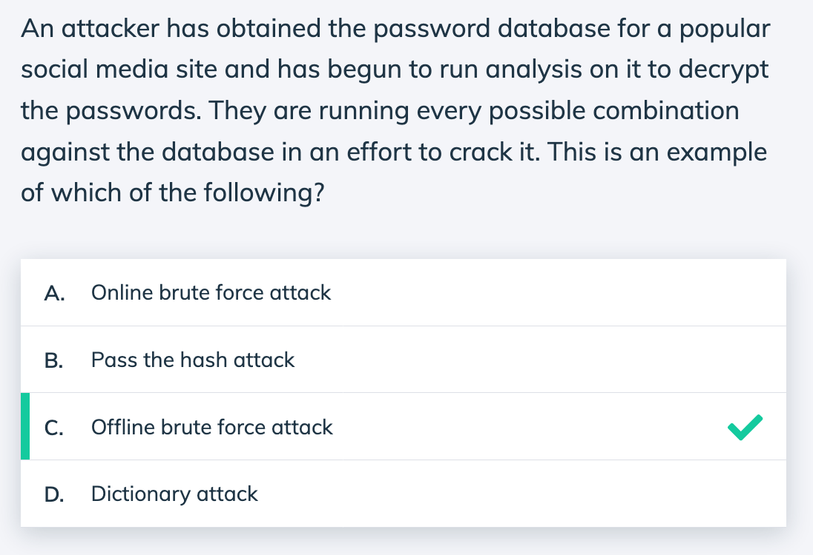
Threats, Attacks, and Vulnerabilities
Explanation:
An offline password attack, or offline brute force attack, is when the attacker attempts to discover the password from a captured database or packet scan.
Some of the most effective methods to mitigate offline attacks are complex passwords and salted password hashes.
An online password attack would occur as a brute force attack against a web application login by repeatedly guessing at the password for an account.
Notes:
John

Slide 10
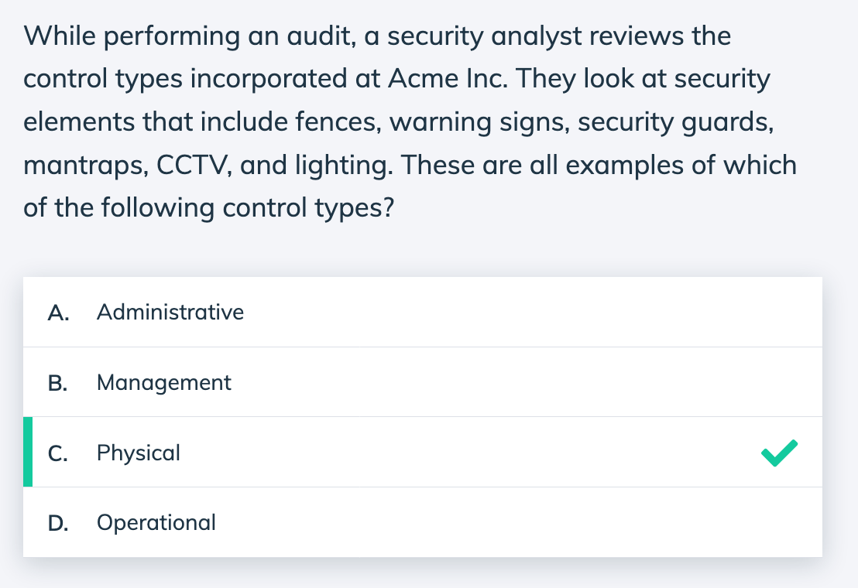
Risk Management
Explanation:
Physical controls are those that can be physically touched. Items such as fences, guard posts, mantraps, lighting, and signs are all included in the physical control category.
Some physical controls are also technical controls, such as CCTV and fire extinguishers, because you can touch them but you use technology to facilitate their function.
Notes:
Harshini

Slide 11
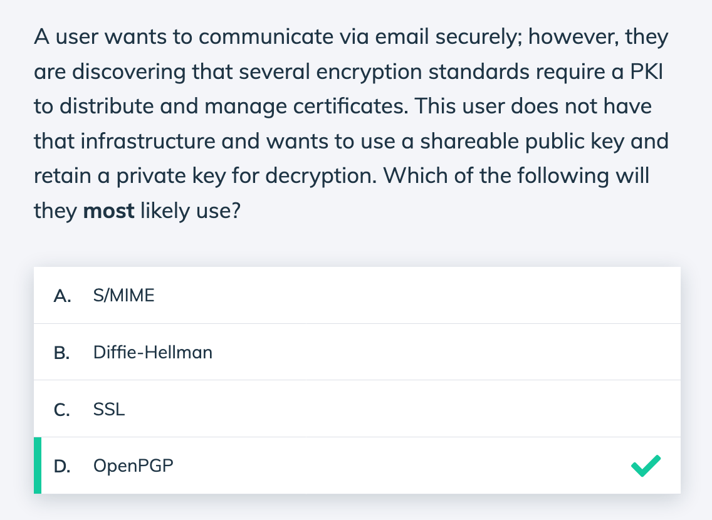
Cryptography and PKI
Explanation:
The various PGP versions (GPG, OpenPGP, PGP) all use the RSA algorithm and public and private keys for encryption and decryption.
They work well in situations where there is no PKI present, as it is possible to provide a public key for users to send the email with an encrypted message and then only the recipient's private key can decrypt the information.
Notes:
Anushka

Slide 12
Thanks!
Any questions?
You can find us at:
wicys@iit.edu
Notes:
Anushka

